Slide 1
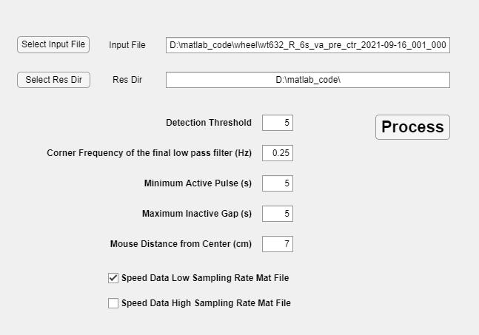
Lur Lab Wheel Speed Analysis GUI
Select Input File
Select Res Dir
Detection Threshold
Corner Frequency of the final low
Pass filer (Hz)
Minimum Active Pulse (s)
Maximum Inactive Gap (s)
Mouse Distance from Center (cm)
Speed Data Low Sampling Rate
Mat File
Speed Data High Sampling Rate
Mat File
Selects the Input file to be used in the analysis
Selects the result directory where the results are saved
Regions higher than Detection Threshold are flagged movement
Controls the amount of filtering applied. The lower the number the more filtering is performed.
Active motion bursts shorter then this are removed
Gaps in motion shorter than this are removed
The distance of the animal from the center of the wheel
When checked a result file with low sampling rate is generated
When checked a result file with high sampling rate is generated

